Slide 2
Augmented Reality and Virtual Reality within Service Stores. Team members: Paula C. Feio and Renato B. Andrade.

Slide 3
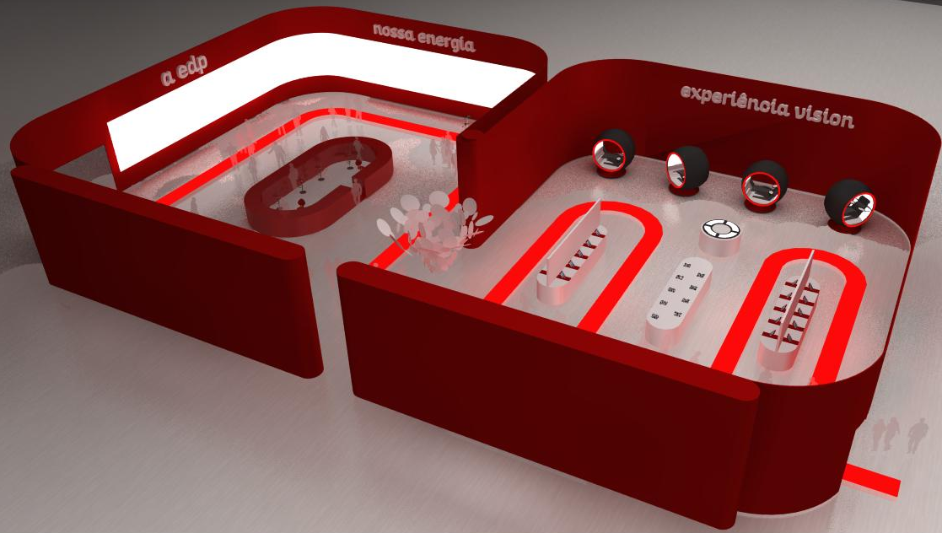
Objective
To research a better and effective future EDP Commercial Store with new technologies.

Slide 4
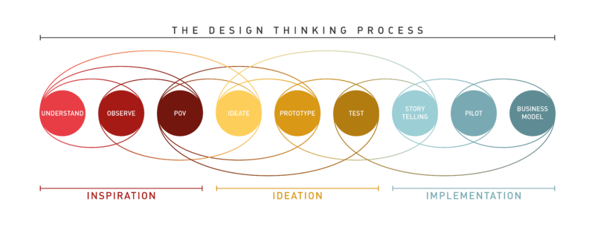
Methodology
Design thinking is a non-linear, iterative process which seeks to understand users, challenges assumptions, redefines problems and creates innovative solutions to prototype and test.

Slide 5

EDP Services
Green Energy (Electricity and Gas).
Technical Assistance.
Health Insurance.
Other Benefits.

Slide 6
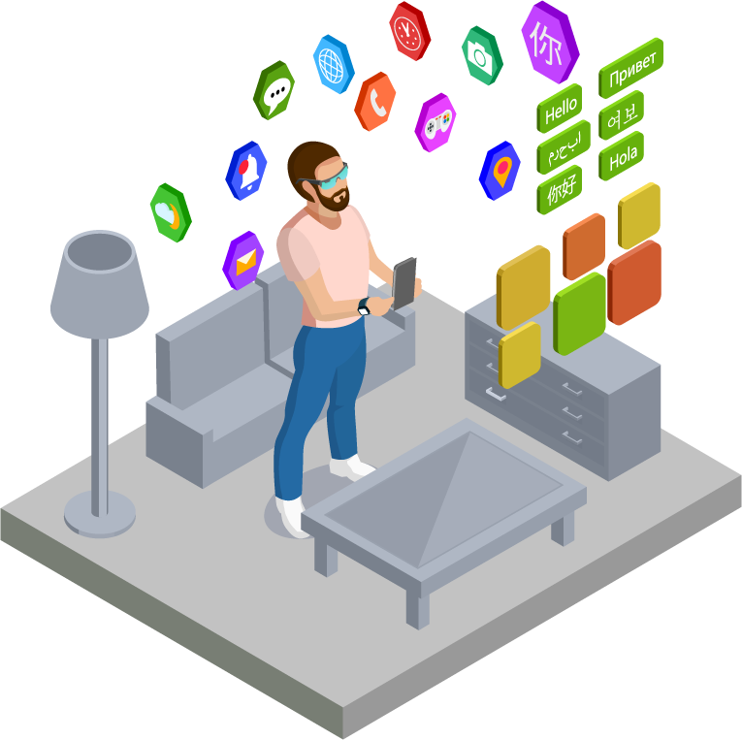
Findings
The Store of the Future must bring a digital and immersive world to the user by expanding the possibilities of our reality with digital elements.
Integration of augmented and virtual reality technologies in the EDP Commercial Store of the Future.

Slide 7
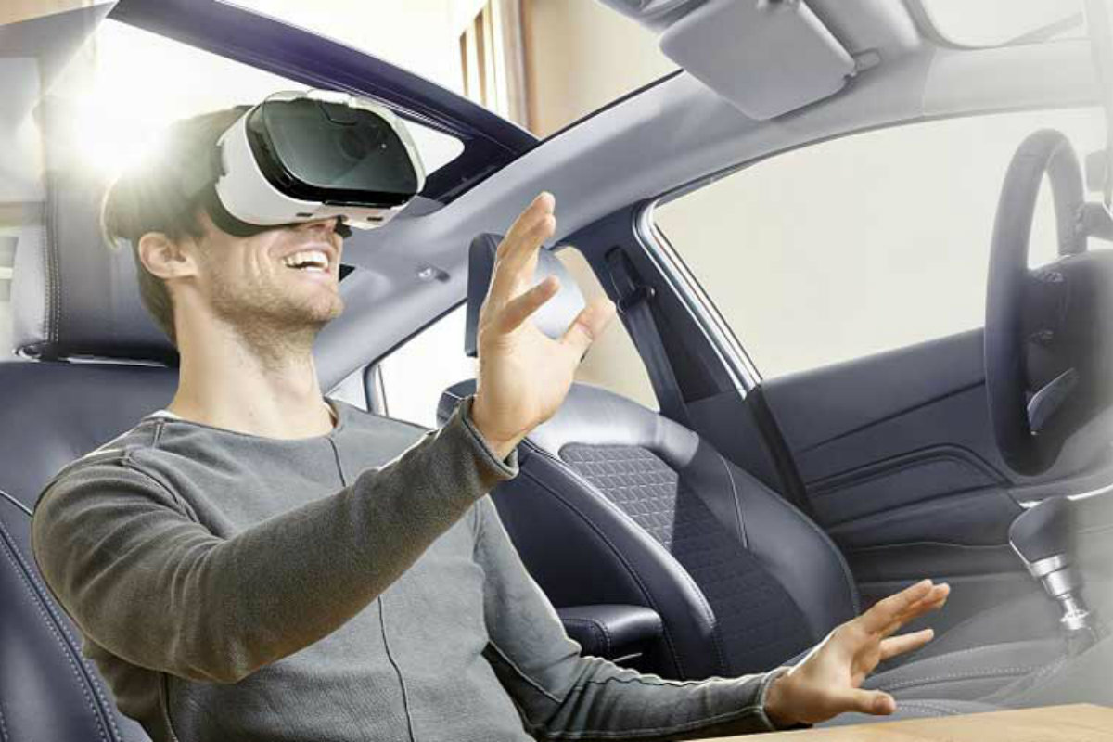
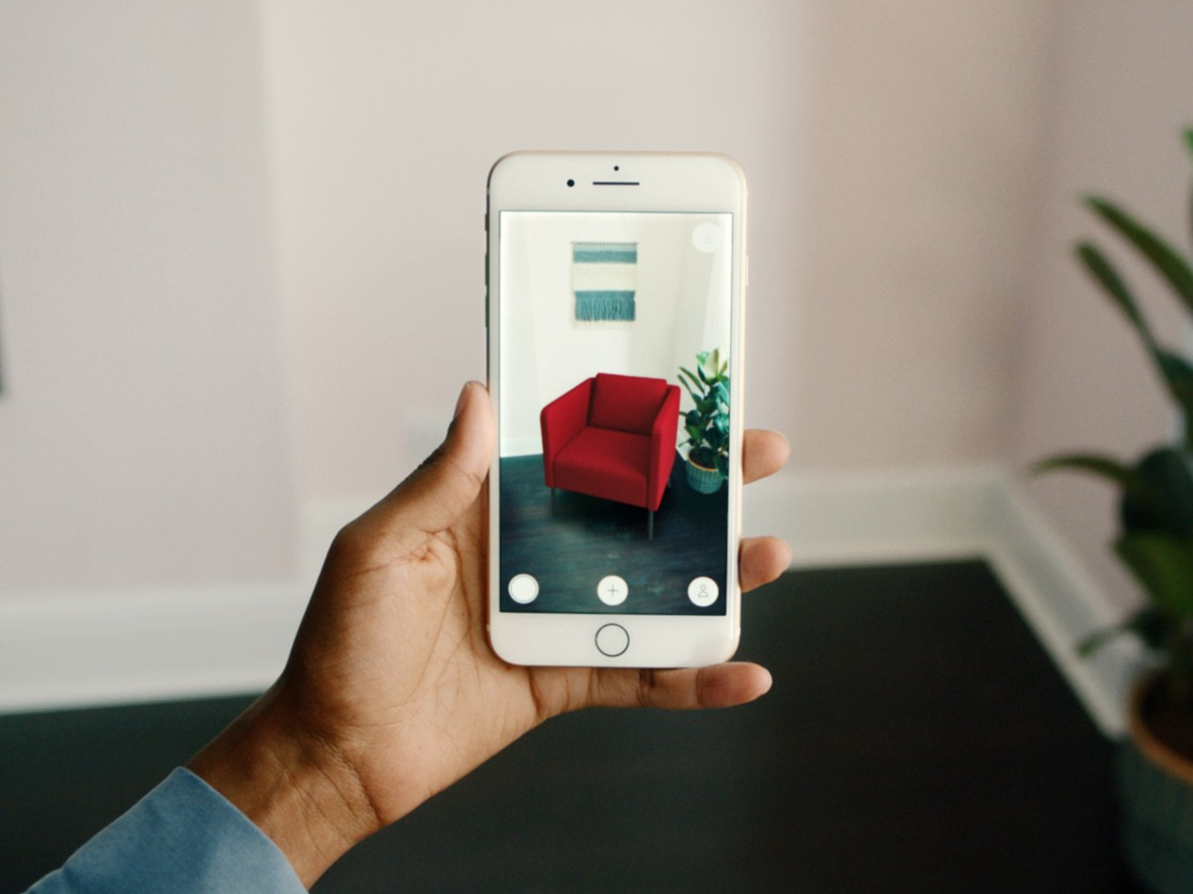
Virtual and Augmented Reality

Slide 8
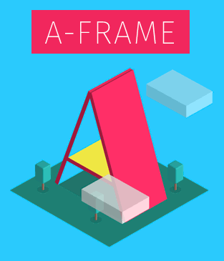



Building the Project
Viro Media e React Native (App) | A-Frame e AR.js (Web)
Open, ARKit and ARCore, Marker, Markerless, Superimposition.
Open, Web, Only Marker Based.

Slide 9
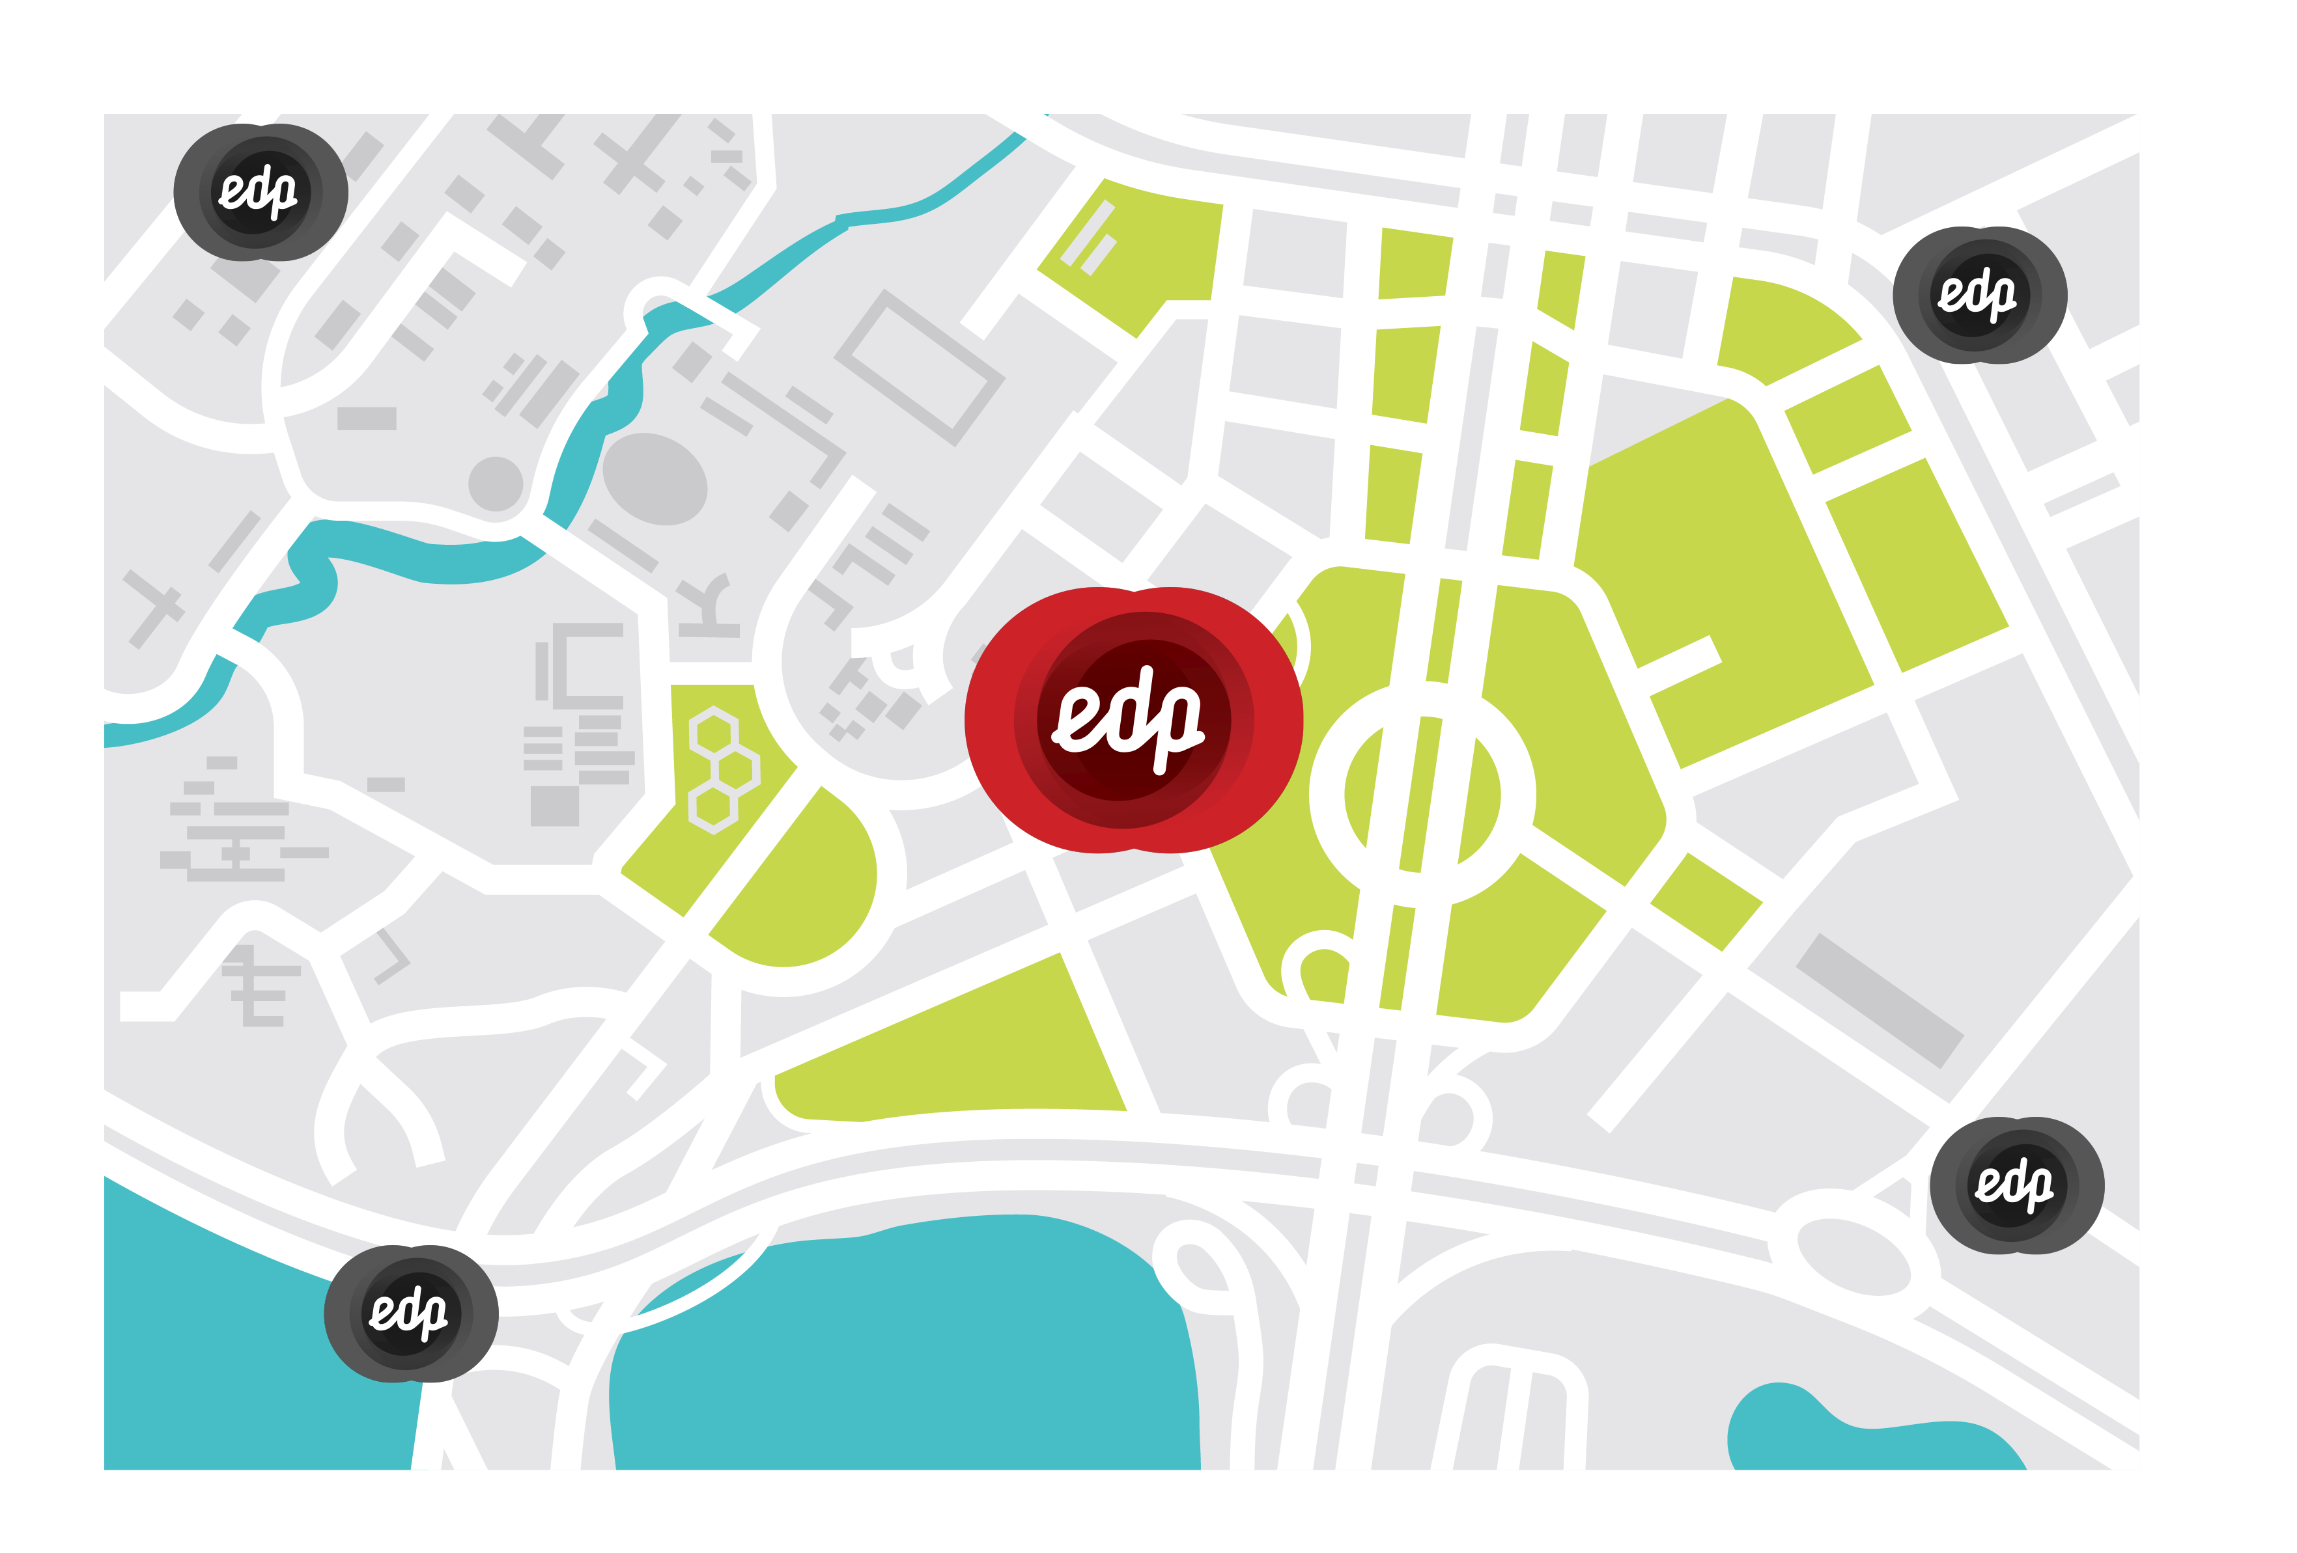
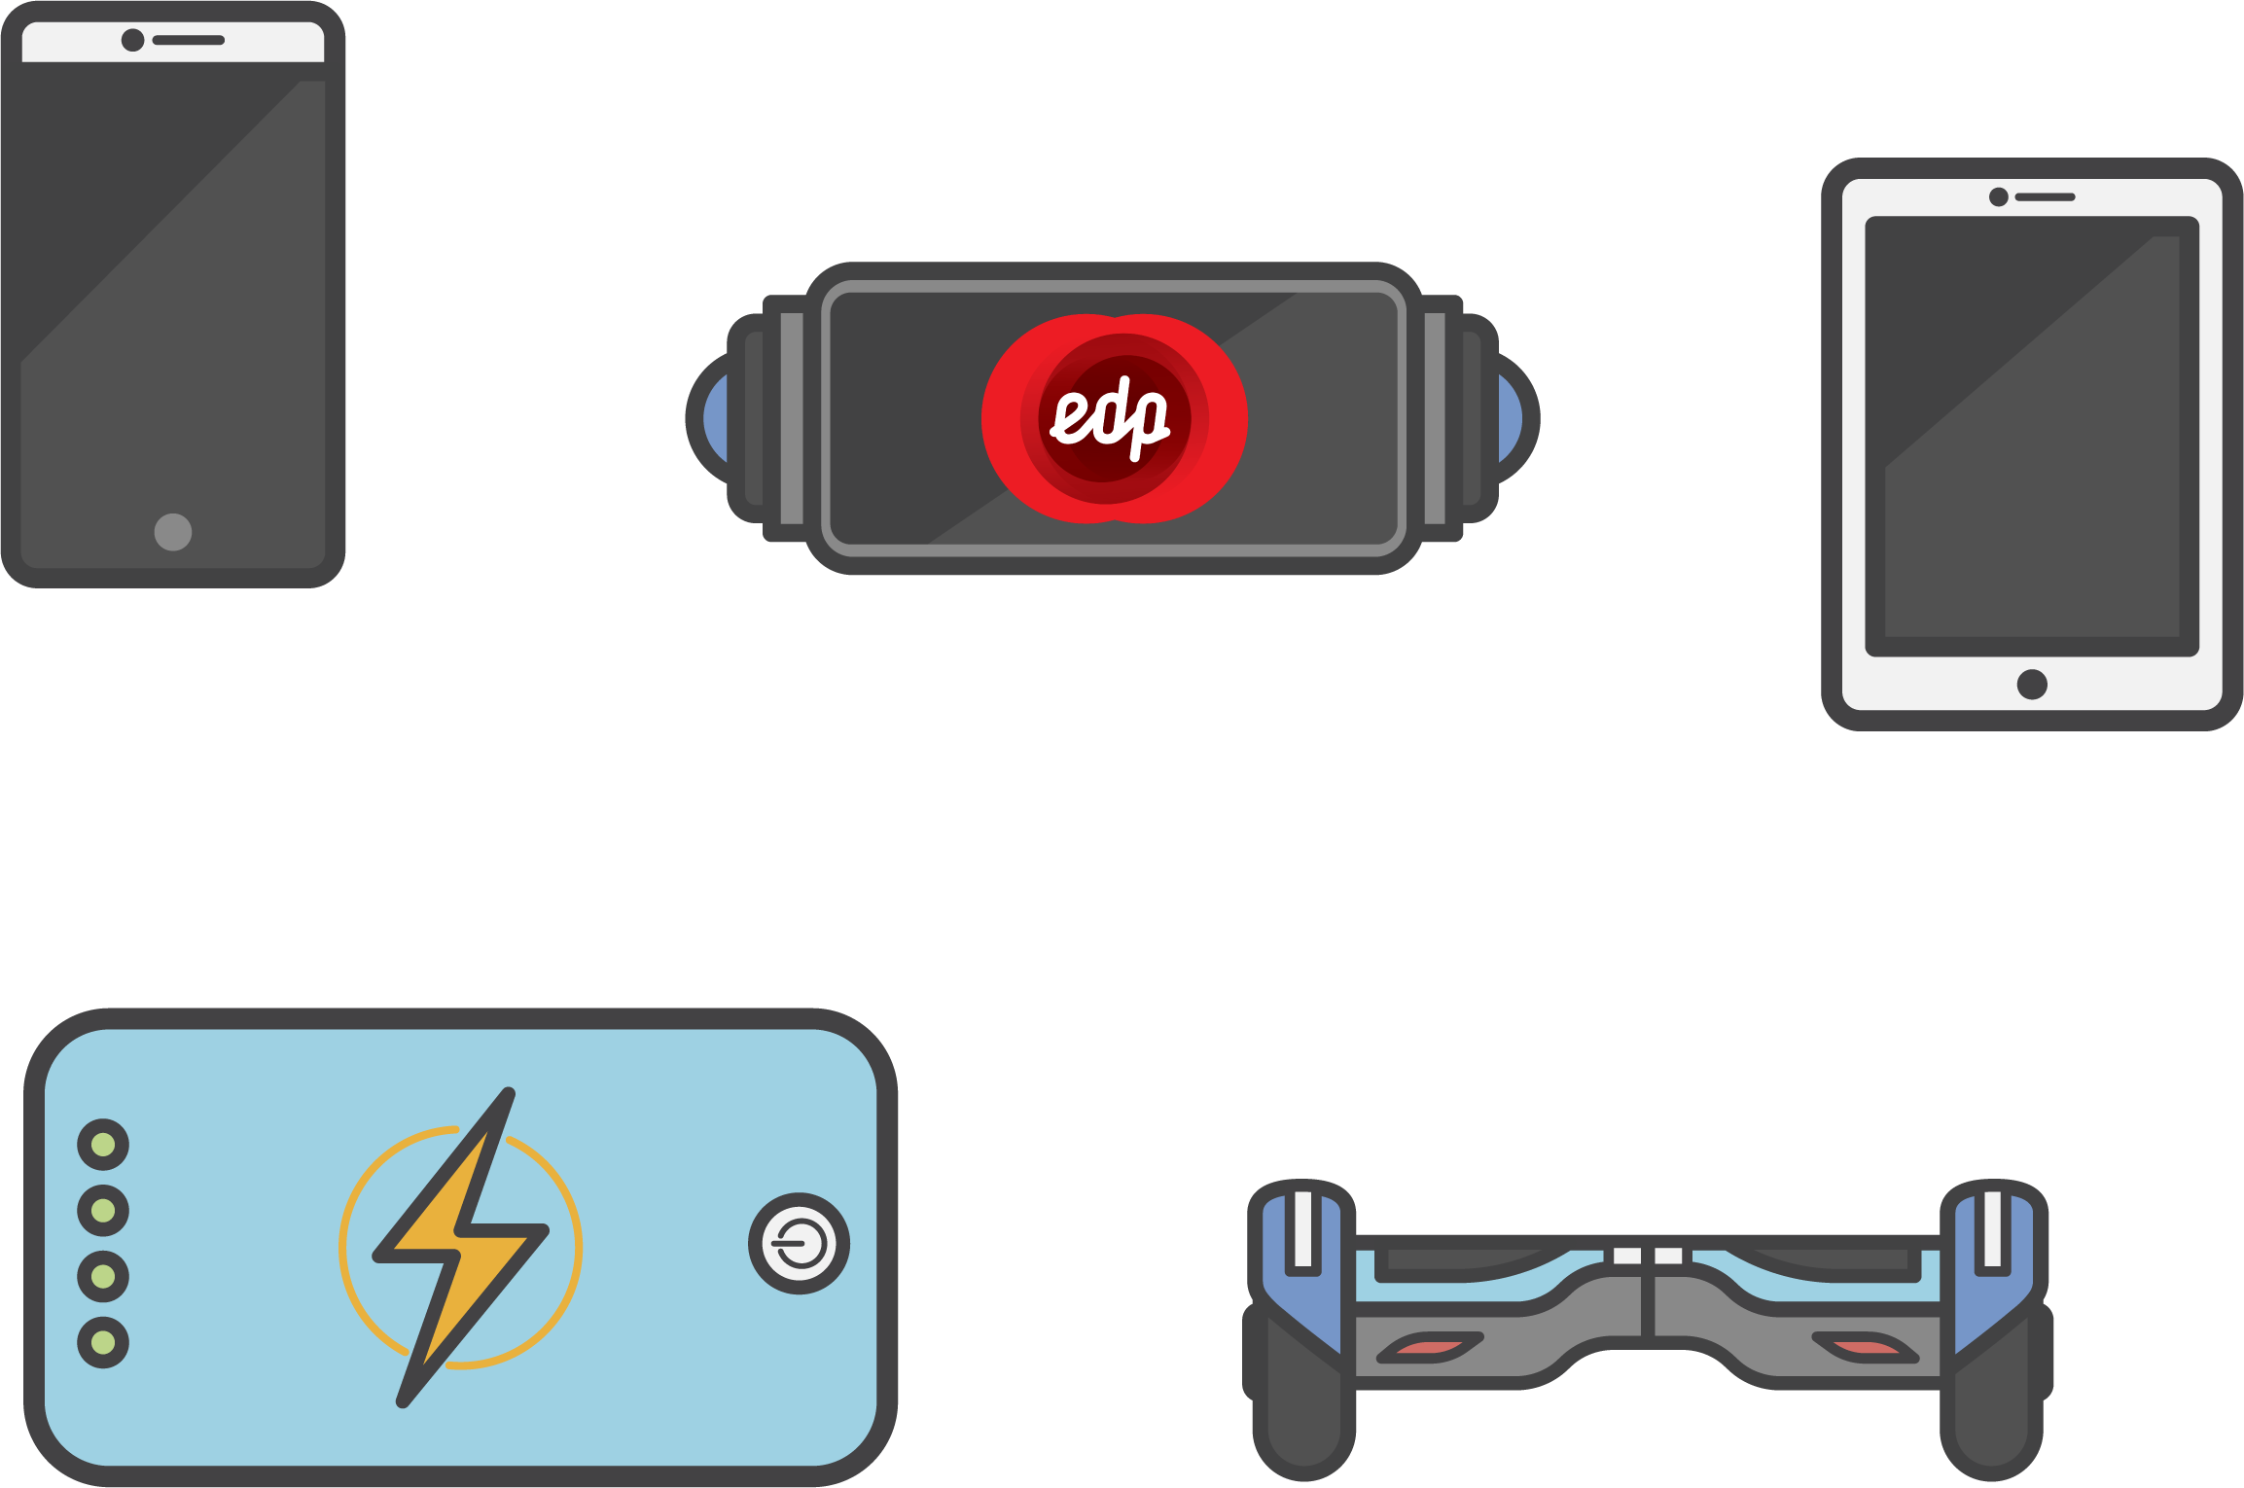
Building the Project
EDP Location(s), Equipment and Utilities.

Slide 10

Building the Project
Programmers, Designers, Other Employees.

Slide 11
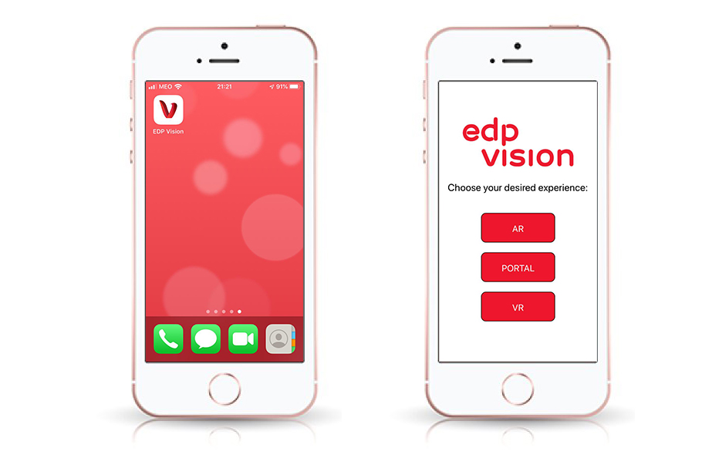
The App

Slide 12
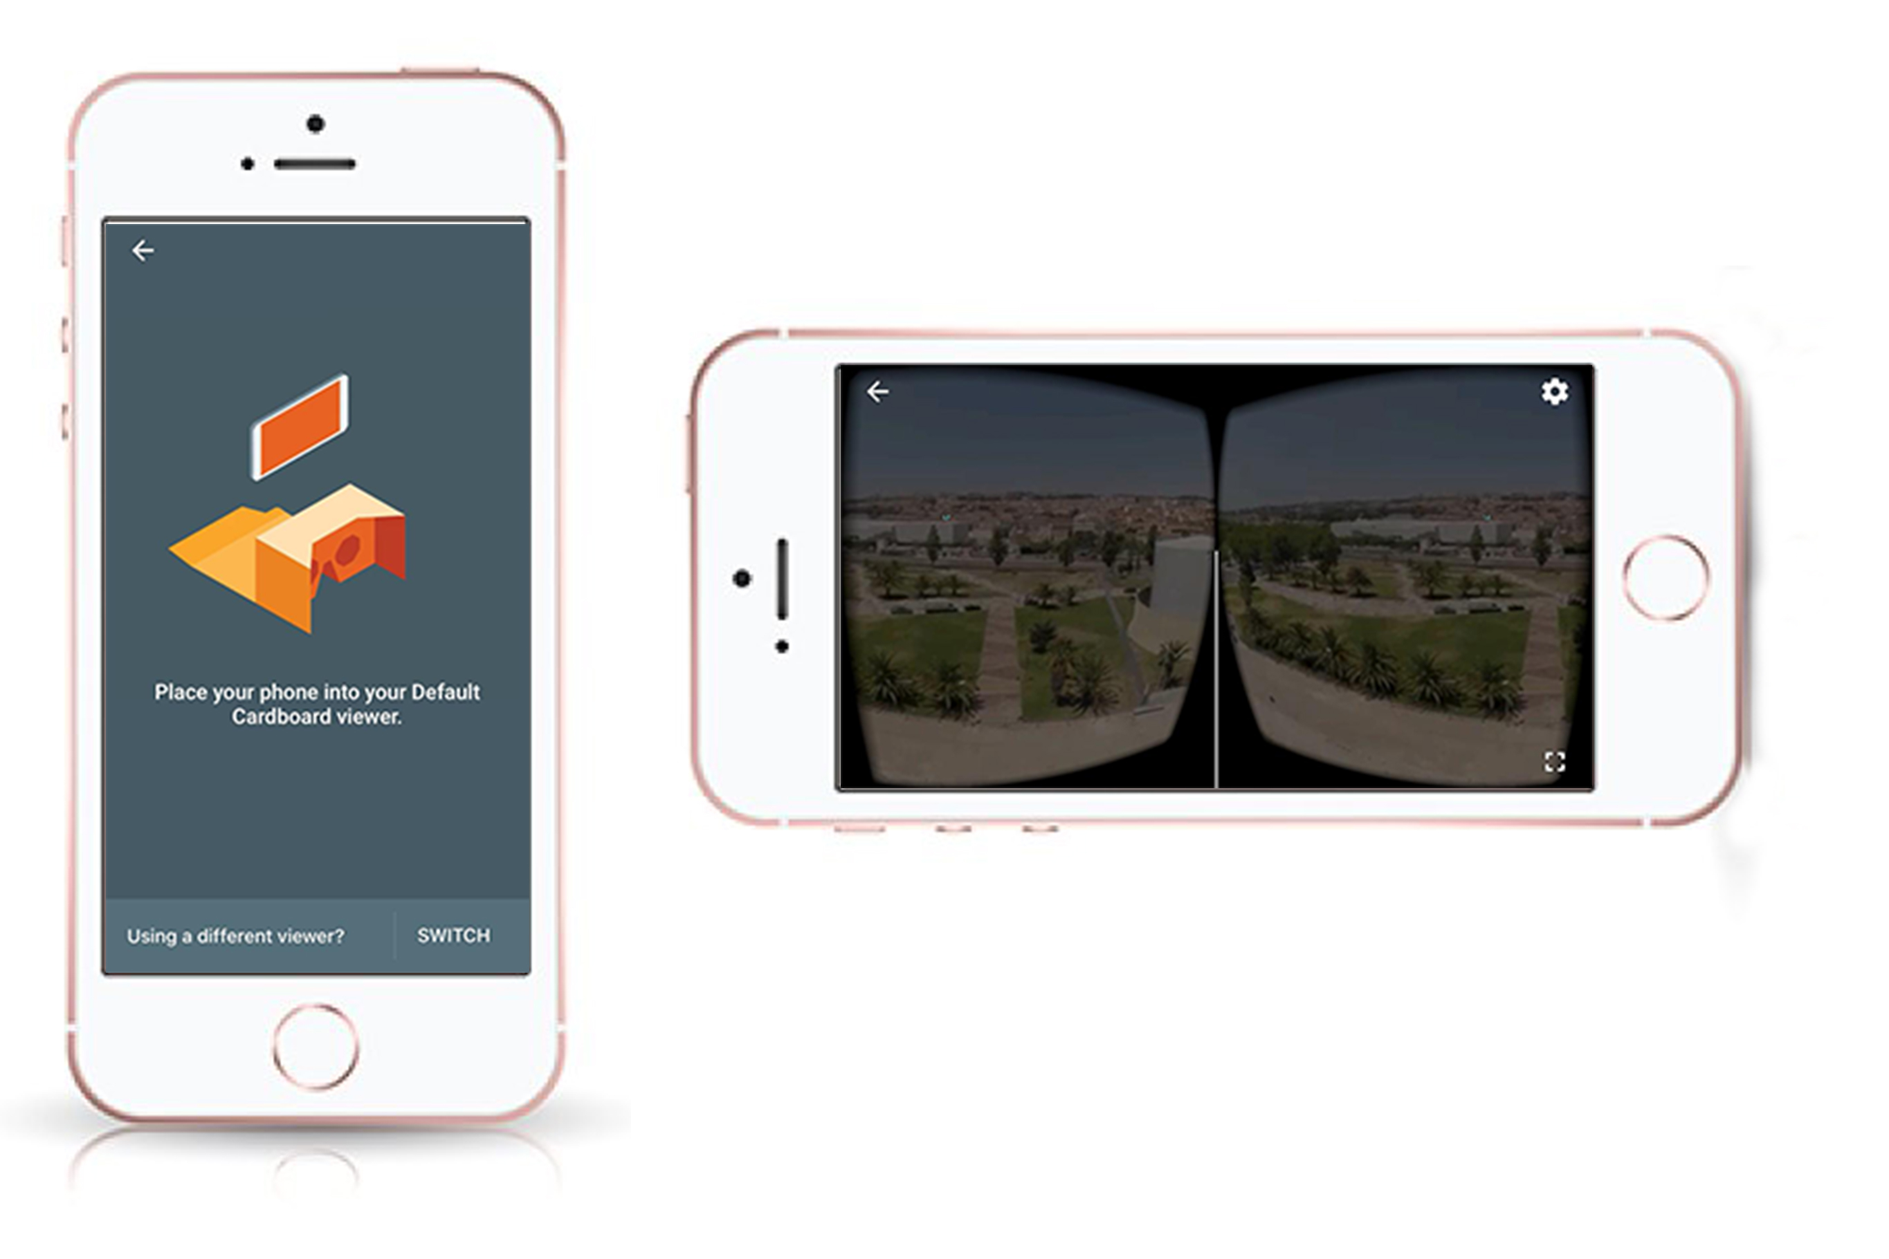
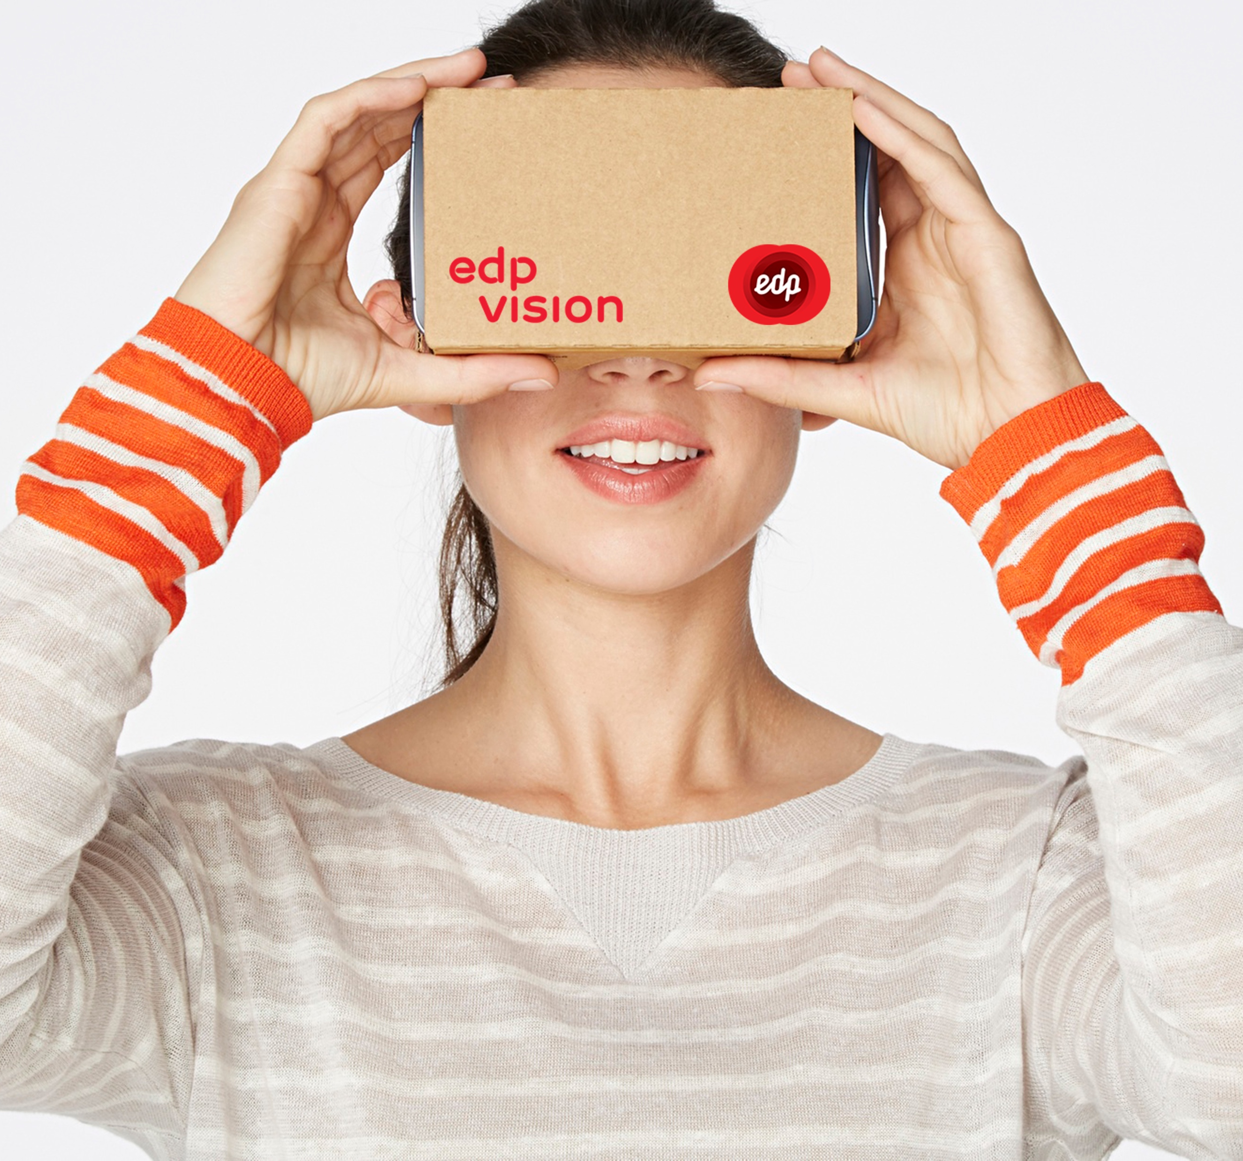
The App - VR

Slide 13
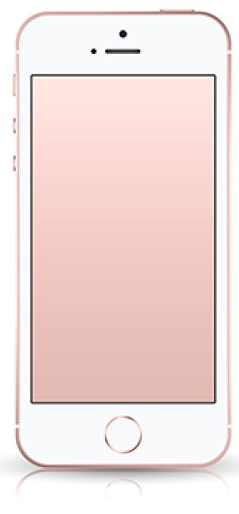
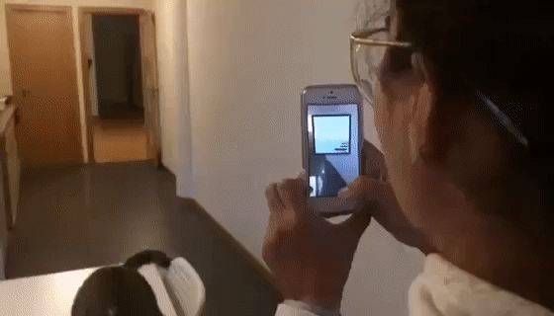
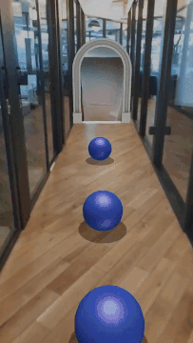
The App - Portal

Slide 14
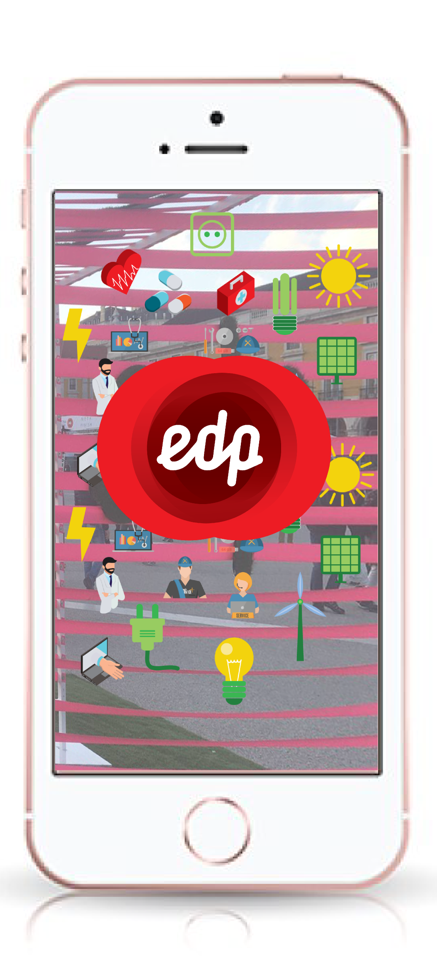
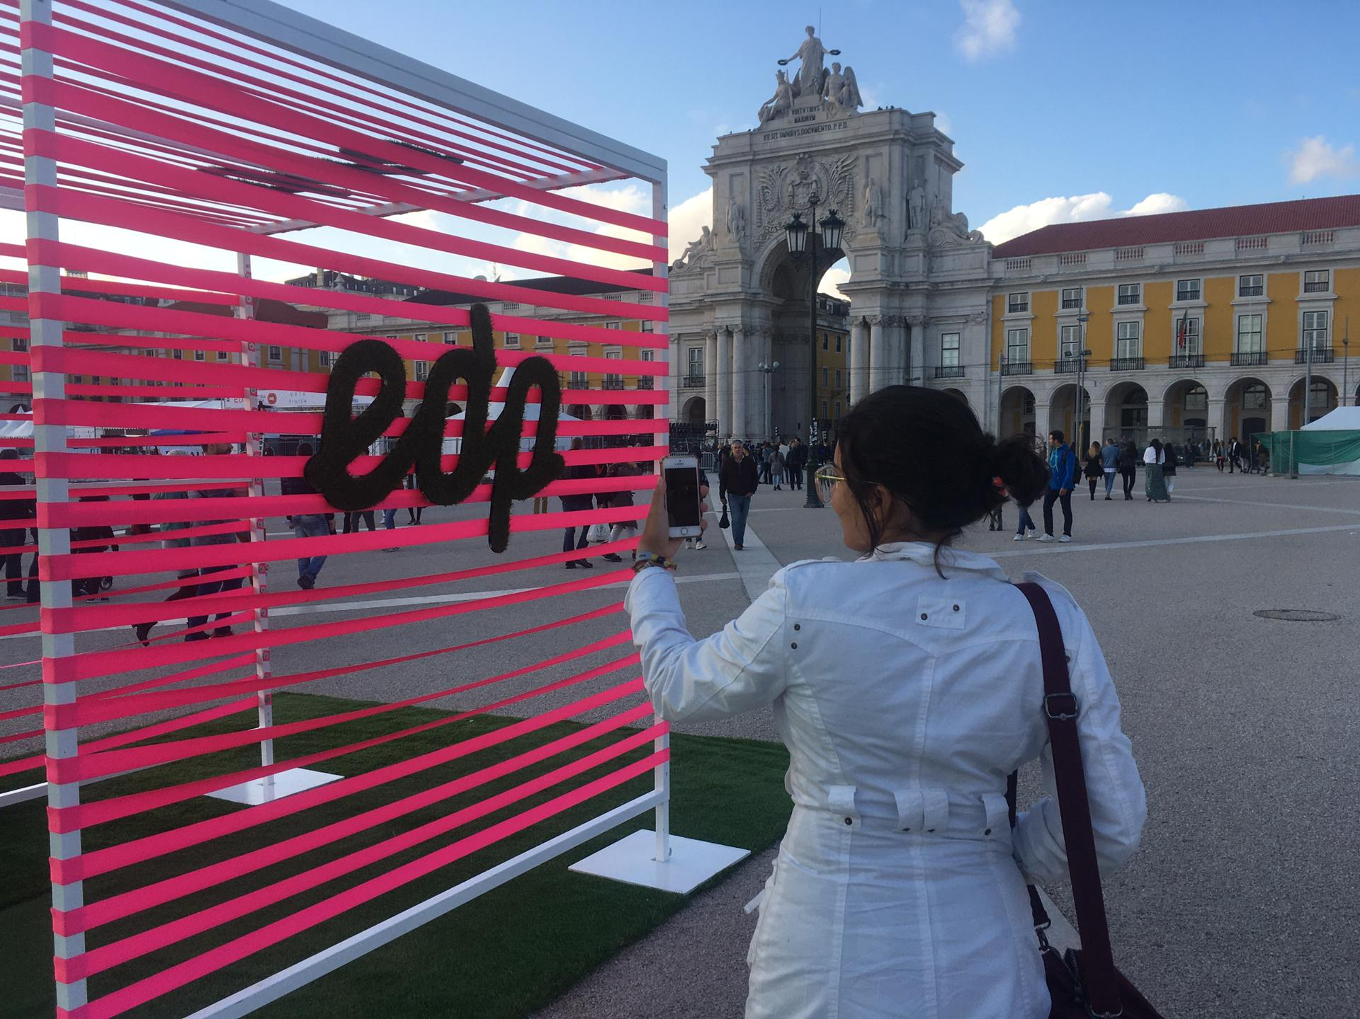
The App - AR

Slide 15
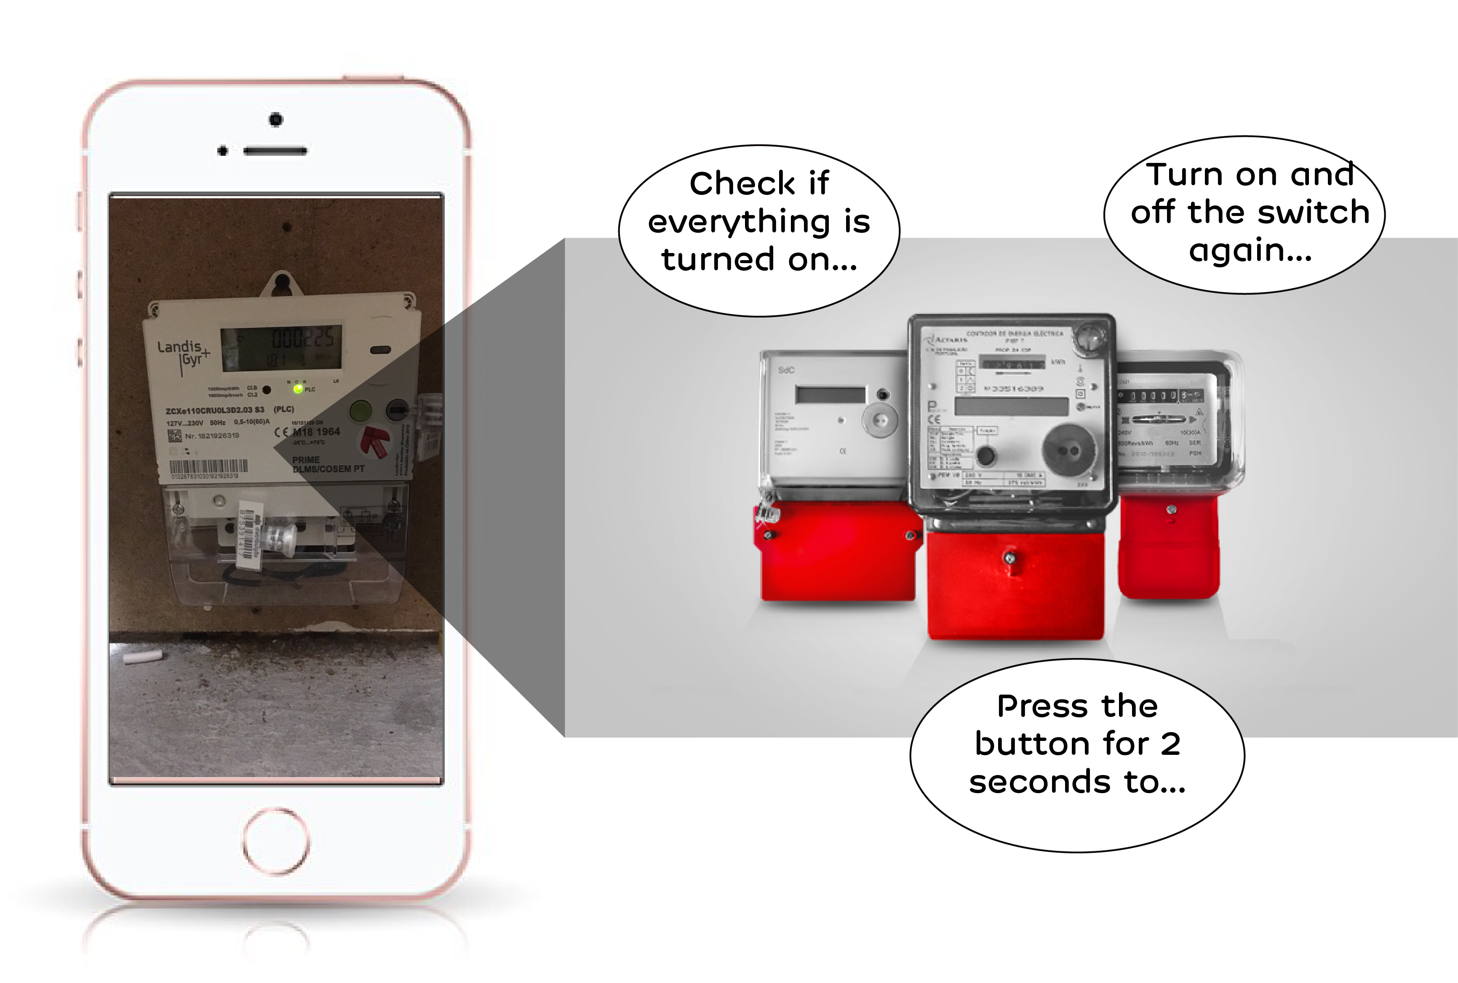
The App

Slide 16

Customer Value
Innovative Customer Experience.
Gamification.
Customer Takes Store to Home.
Learning About Products and Benefits.

Slide 17

Revenue
Builds Customer Loyalty.
Attraction to New Customers.
Marketing and Brand Building of Values.
Opens New Sales Channel with Costumers.

Slide 18
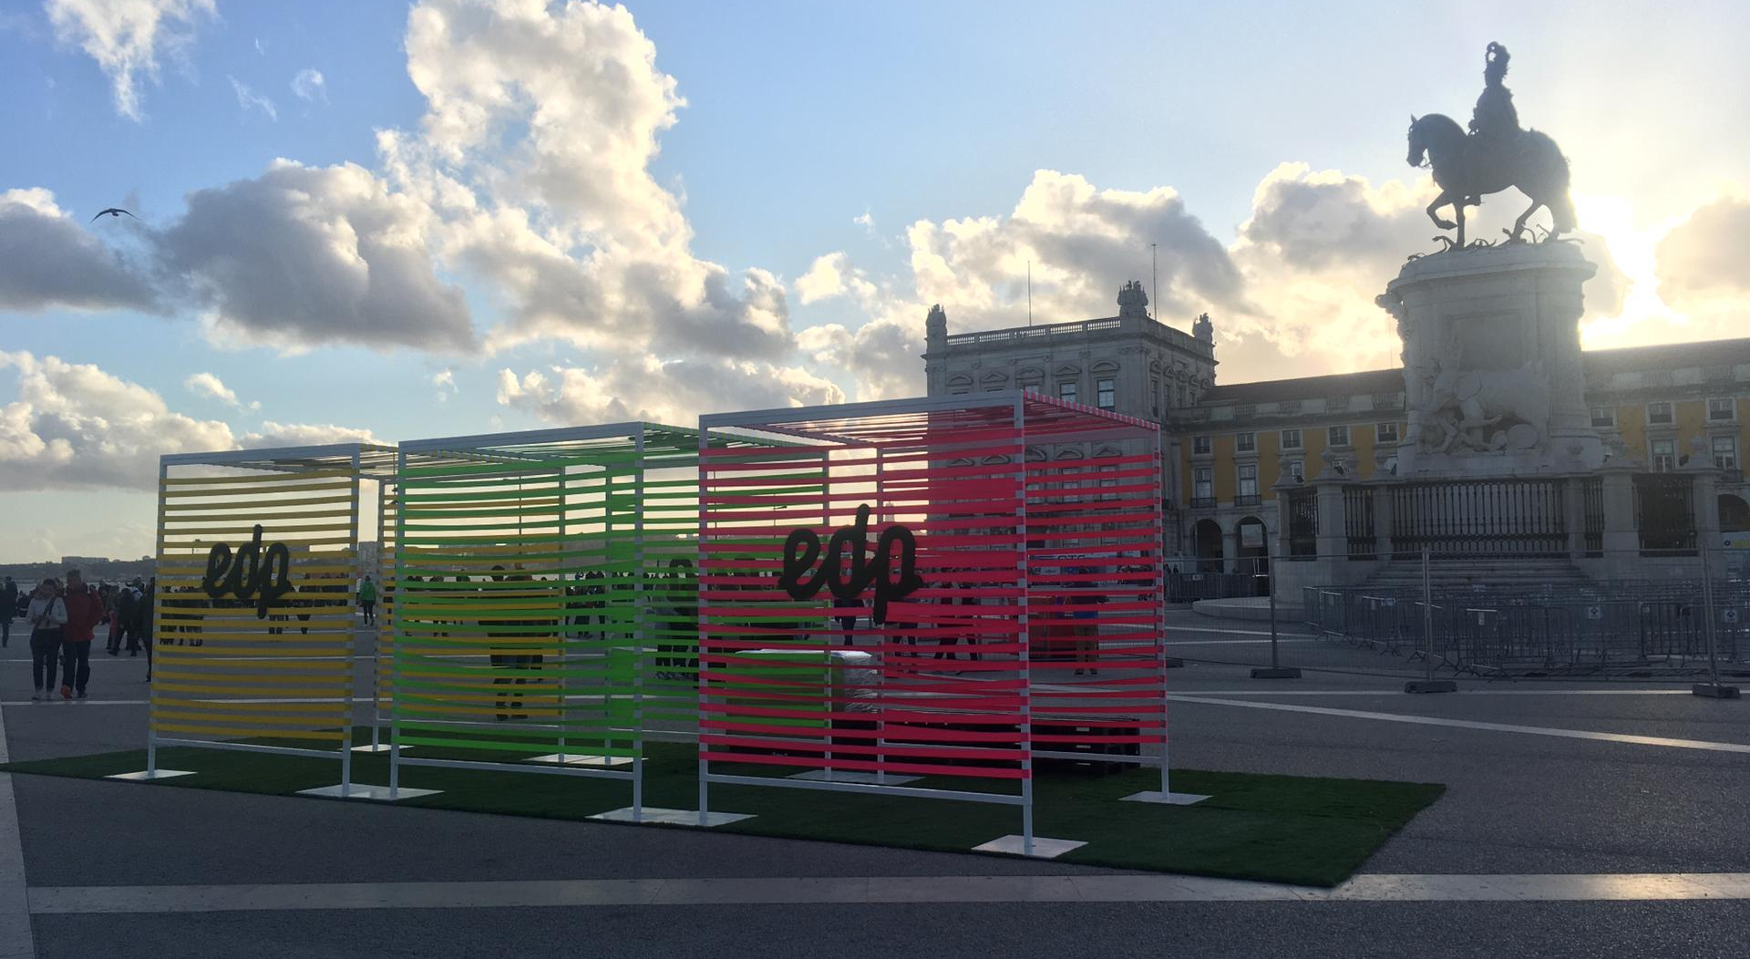
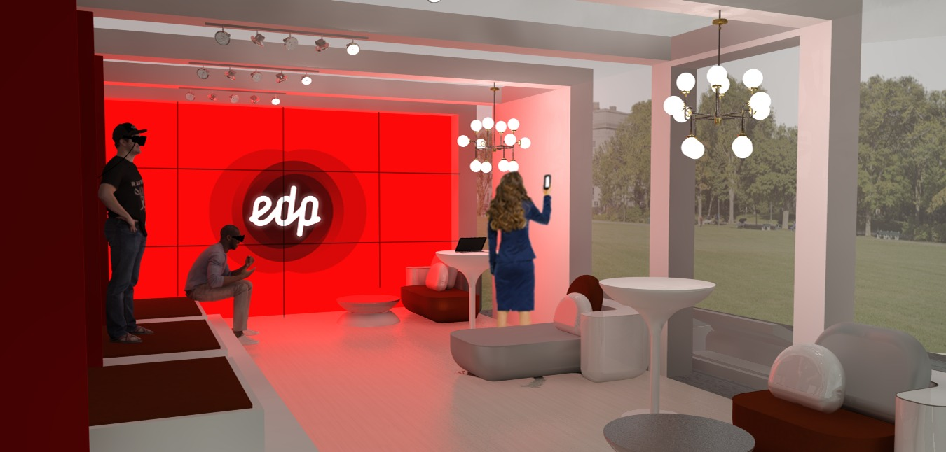
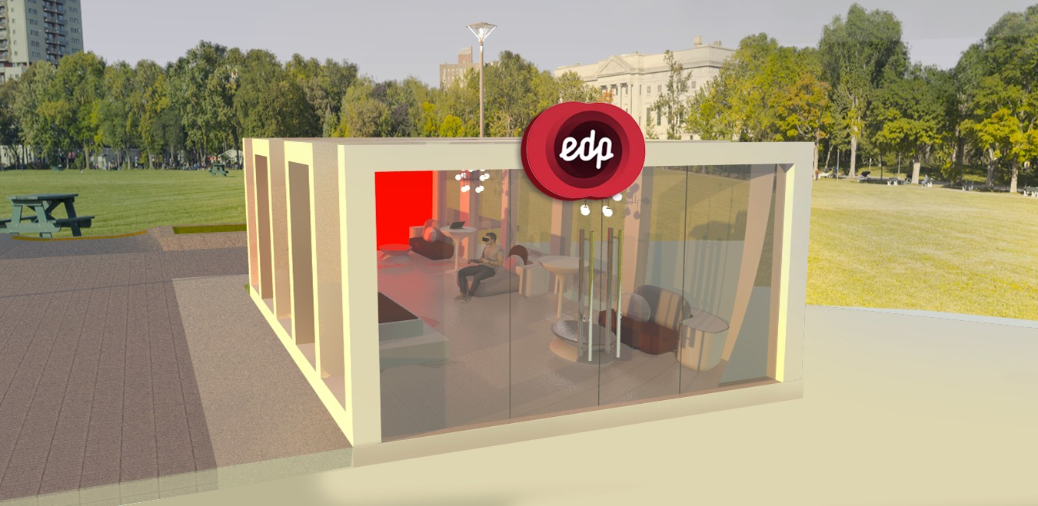
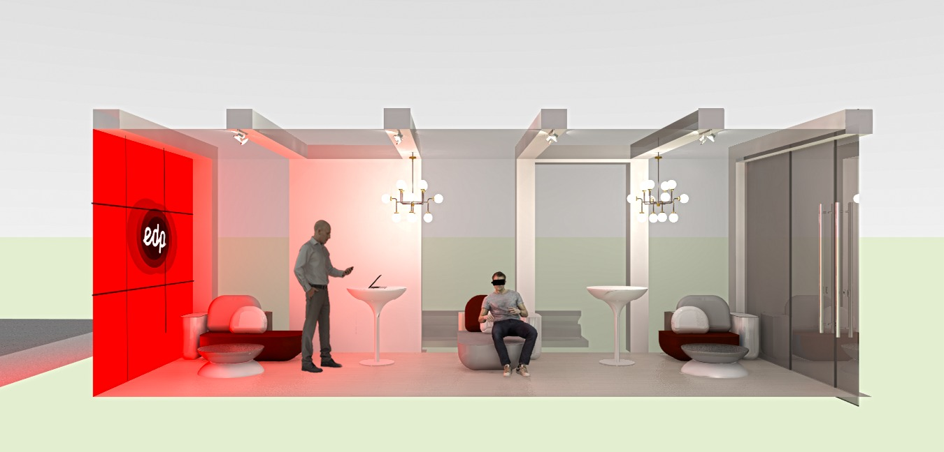
Concept Pop-up Store

Slide 19
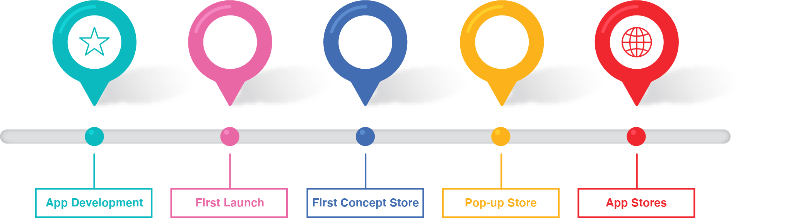
The Project
3 to 6 months: development for the Application.
6 months: Test with public at an event.
8 months: Open of the First Concept Store.
10 months: Pop-up Store events.
12+ months: Launch on Appstore and Google Play.

Slide 20
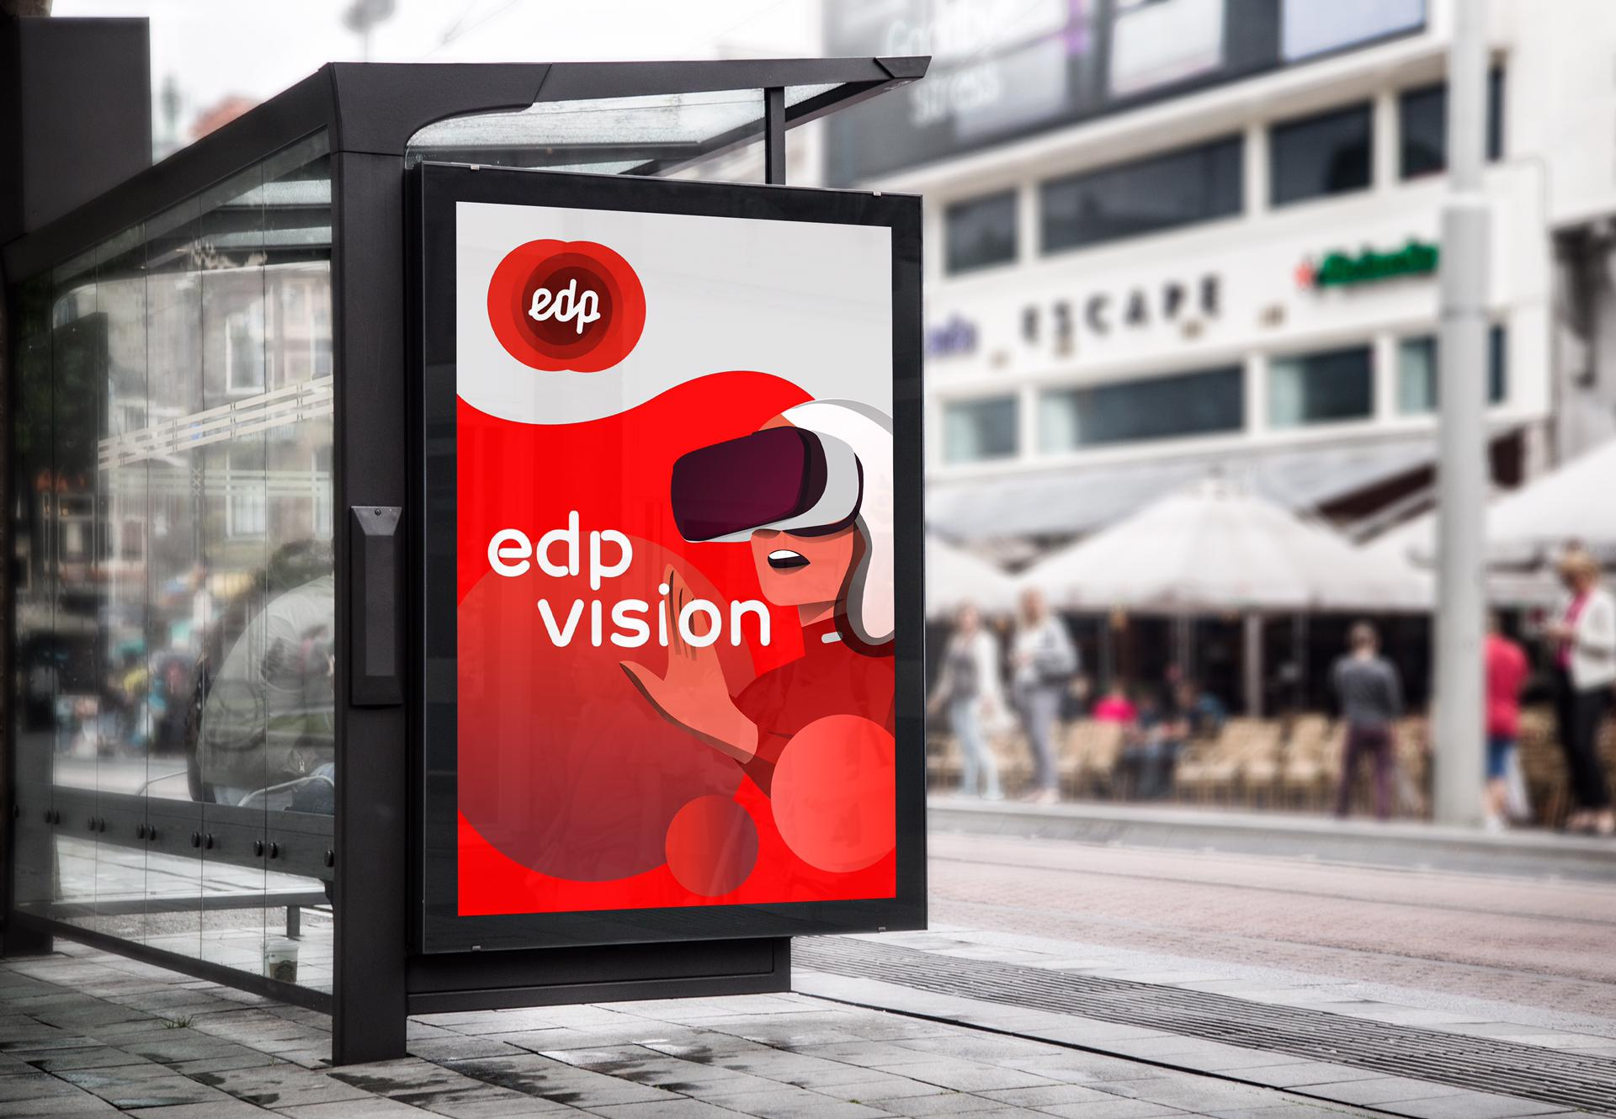
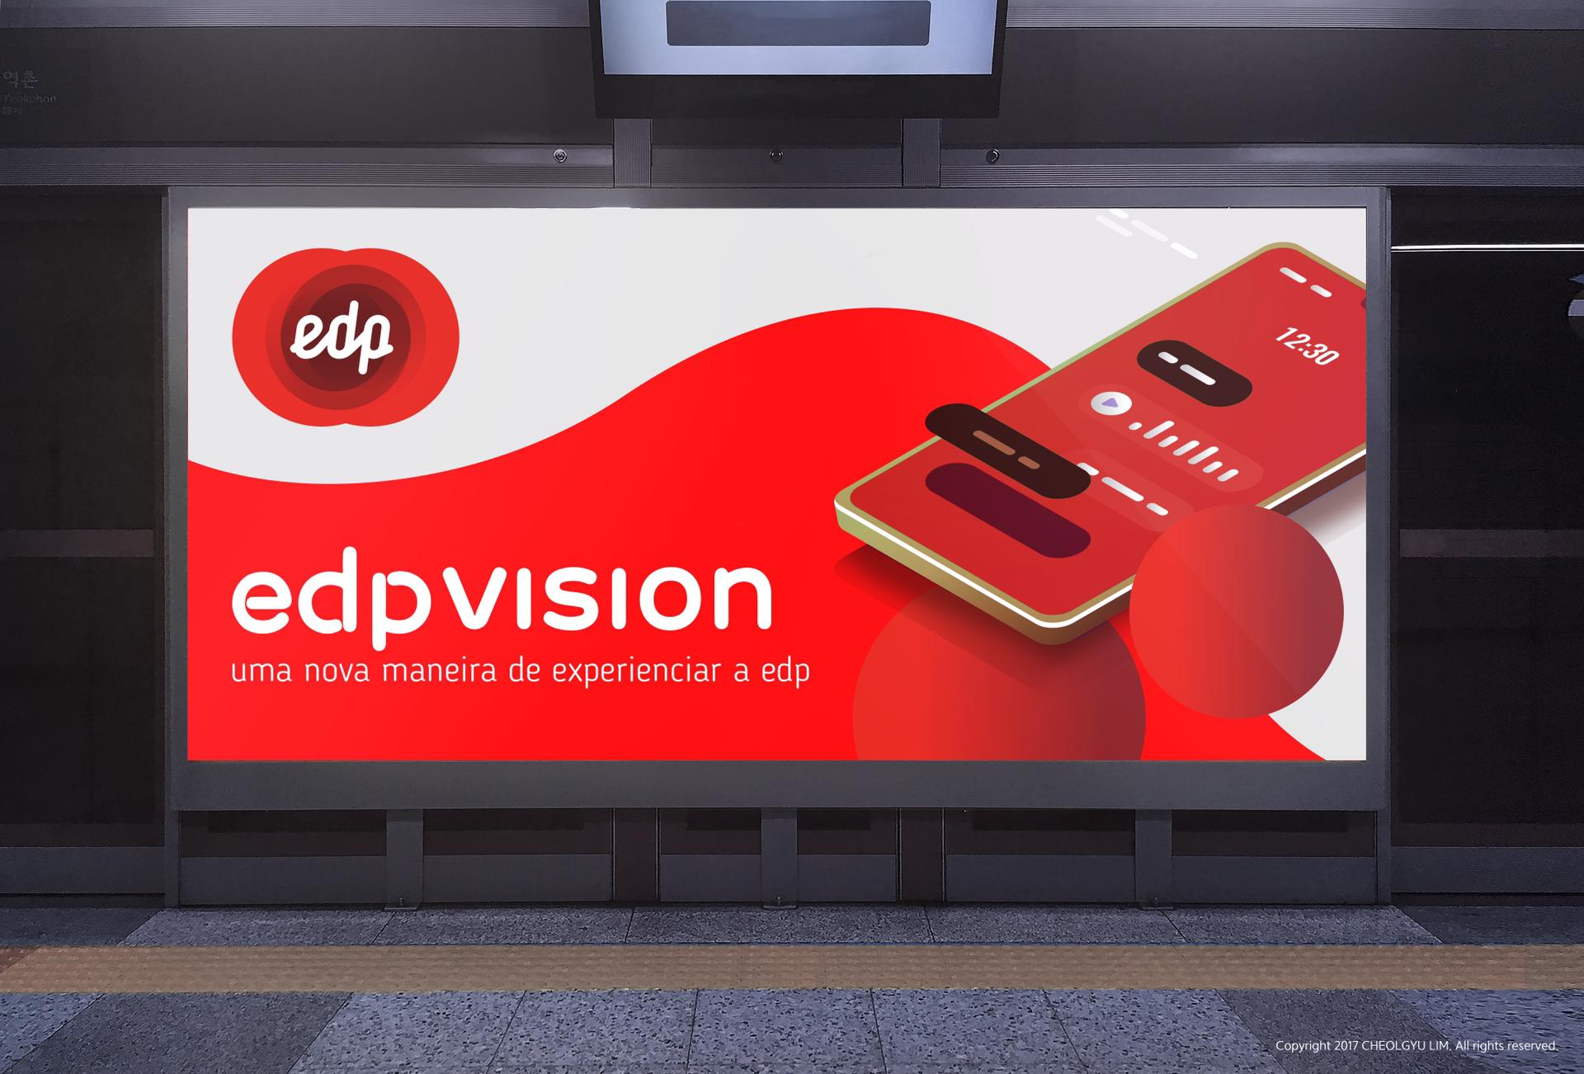
EDP Vision

Slide 21

EDP Vision
A new way to experience EDP.

Slide 22
THANK YOU

